Slide 1
Vector Semantics & Embeddings
Word Meaning (lexical)

Slide 2
What do words mean?
Next thought: look in a dictionary
http://www.oed.com/

Slide 3
Words, Lemmas, Senses, Definitions
lemma
sense
definition

Slide 4
Lemma pepper
Sense 1: spice from pepper plant
Sense 2: the pepper plant itself
Sense 3: another similar plant (Jamaican pepper)
Sense 4: another plant with peppercorns (California pepper)
Sense 5: capsicum (i.e. chili, paprika, bell pepper, etc)
A sense or “concept” is the meaning component of a word

Slide 5
Relations between senses: Synonymy
Synonyms have the same meaning in some or all contexts.
filbert / hazelnut
couch / sofa
big / large
automobile / car
vomit / throw up
water / H₂0

Slide 6
Relation: Synonymy
Note that there are probably no examples of perfect synonymy.
Even if many aspects of meaning are identical
Still may not preserve the acceptability based on notions of politeness, slang, register, genre, etc.

Slide 7
The Linguistic Principle of Contrast
Difference in form → difference in meaning

Slide 8
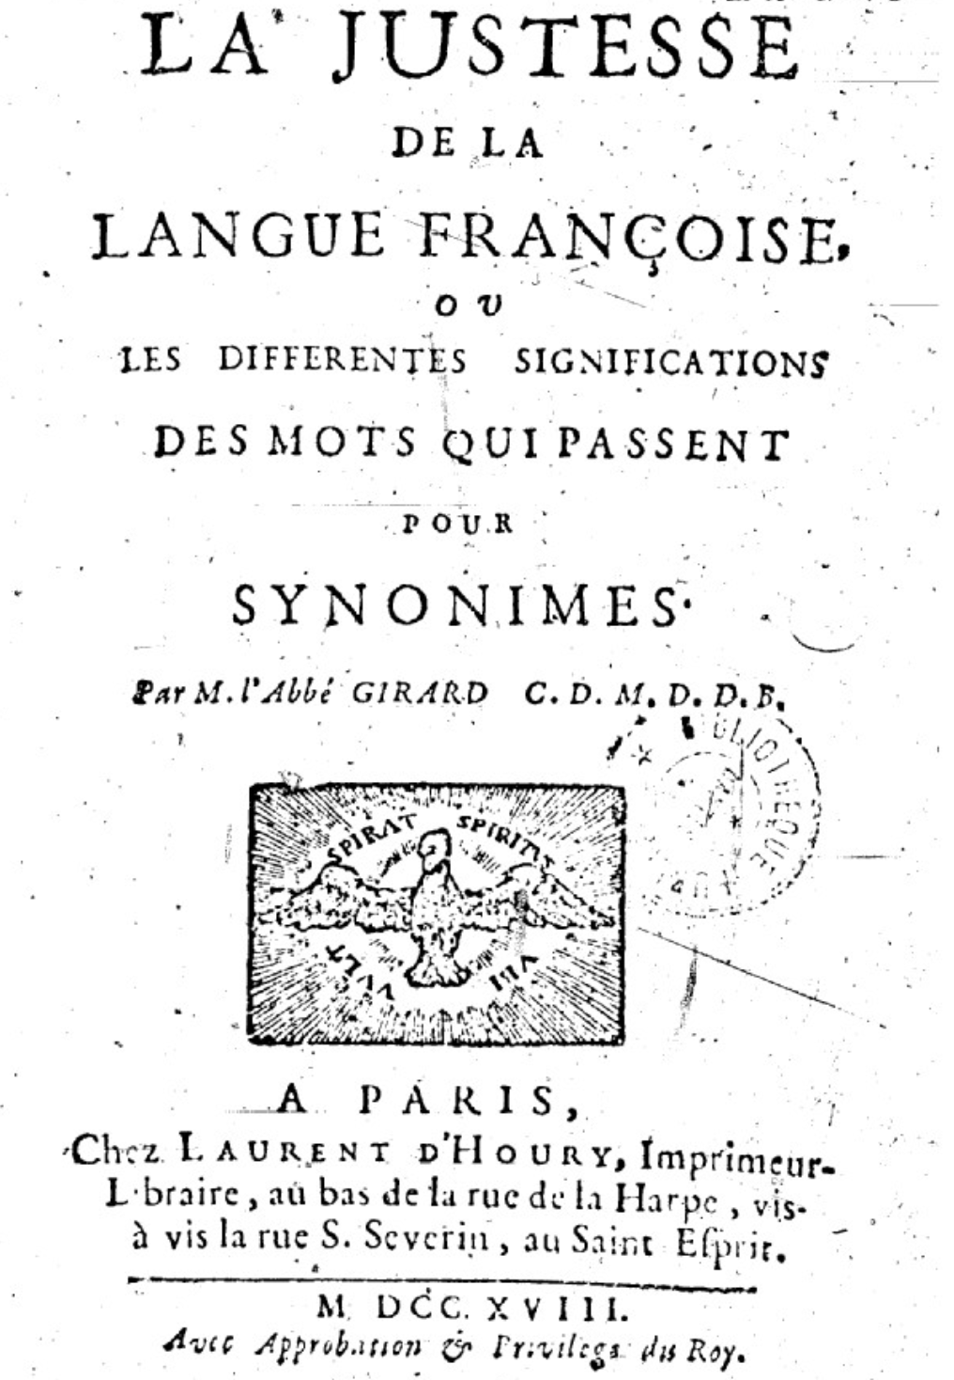
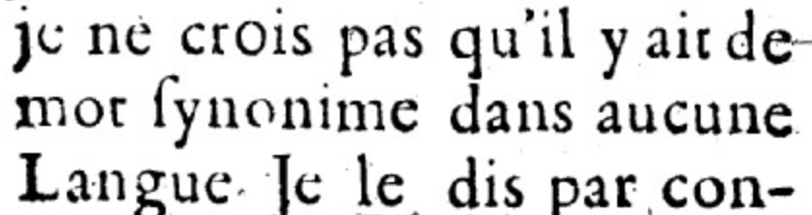
Abbé Gabriel Girard 1718
Re: "exact" synonyms
"
"
[I do not believe that there is a synonymous word in any language]

Slide 9
Relation: Similarity
Words with similar meanings. Not synonyms, but sharing some element of meaning
car, bicycle
cow, horse

Slide 10
Ask humans how similar 2 words are
word1 | word2 | similarity
vanish | disappear | 9.8
behave | obey | 7.3
belief | impression | 5.95
muscle | bone | 3.65
modest | flexible | 0.98
hole | agreement | 0.3
SimLex-999 dataset (Hill et al., 2015)

Slide 11
Relation: Word relatedness
Also called "word association"
Words can be related in any way, perhaps via a semantic frame or field
car, bicycle: similar
car, gasoline: related, not similar

Slide 12
Semantic field
Words that
cover a particular semantic domain
bear structured relations with each other.
hospitals
surgeon, scalpel, nurse, anaesthetic, hospital
restaurants
waiter, menu, plate, food, menu, chef
houses
door, roof, kitchen, family, bed

Slide 13
Relation: Antonymy
Senses that are opposites with respect to only one feature of meaning
Otherwise, they are very similar!
dark/light short/long fast/slow rise/fall
hot/cold up/down in/out
More formally: antonyms can
define a binary opposition or be at opposite ends of a scale
long/short, fast/slow
Be reversives:
rise/fall, up/down

Slide 14
Relation: Superordinate/ subordinate
One sense is a subordinate of another if the first sense is more specific, denoting a subclass of the other
car is a subordinate of vehicle
mango is a subordinate of fruit
Conversely superordinate
vehicle is a superordinate of car
fruit is a superodinate of mango
Superordinate | vehicle | fruit | furniture
Subordinate | car | mango | chair

Slide 15
Cluster of Interactional Properties
Basic level things are “human-sized”
Consider chairs
We know how to interact with a chair (sit)
Not so clear for superordinate categories like furniture
“Imagine a furniture without thinking of a bed/table/chair/specific basic-level category”

Slide 16
The basic level
Distinctive actions
Learned earliest in childhood
Names are shortest
Names are most frequent

Slide 17
Connotation (sentiment)
Words have affective meanings
positive connotations (happy)
negative connotations (sad)
positive evaluation (great, love)
negative evaluation (terrible, hate).

Slide 18
Connotation
Osgood et al. (1957)
Words seem to vary along 3 affective dimensions:
valence: the pleasantness of the stimulus (e.g.: unhappy vs. happy)
arousal: the intensity of emotion provoked by the stimulus (excited vs. calm)
dominance: the degree of control exerted by the stimulus (controlling vs. awed)

Slide 19
So far
Concepts or word senses
Have a complex many-to-many association with words (homonymy, multiple senses)
Have relations with each other
Synonymy
Antonymy
Similarity
Relatedness
Superordinate/subordinate, basic level
Connotation

Slide 20
참고사항
http://wordnetweb.princeton.edu/perl/webwn

Slide 21
WordNet Applications
참고사항
Information Extraction
Information retrieval
Question Answering
Word Sense Disambiguation
Text Inference
Coreference, coherence and metonymy
Knowledge acquisition
Internet Search engine

Slide 22
WordNet Limitations
참고사항
Designed as a semantic lexicon, not a knowledge base
Limited connections between topically related words
Lack of morphological relationships
Lack of selectional restriction
…
Harabagiu, S. M., Miller, G. A., & Moldovan, D. I. (1999). Wordnet 2-a morphologically and semantically enhanced resource. SIGLEX99: Standardizing Lexical Resources.

Slide 23
WordNet Corpus
A large lexical database of English (http://wordnet.princeton.edu)
Nouns, verbs, adjectives and adverbs are grouped into sets of cognitive synonyms (synsets), each expressing a distinct concept
Synsets are interlinked by means of conceptual-semantic and lexical relations
WordNet interlinks not just word forms—strings of letters—but specific senses of words
Words that are found in close proximity to one another in the network are semantically disambiguated
Using synsets, helps find conceptual relationships between words such as hypernyms, hyponyms, synonyms, antonyms etc.
lemma: 대표어 ➔ 여기서는Type 혹은 Instance.Type

Slide 24
Lemma class
Create A Lemma from a "<word>.<pos>.<number>.<lemma>" string
<word> : the morphological stem identifying the synset
<pos> : one of the module attributes ADJ, ADJ_SAT, ADV, NOUN or VERB
<number> : the sense number, counting from 0
<lemma> : the morphological form of interest
Note that <word> and <lemma> can be different
e.g. the Synset 'salt.n.03' has the Lemmas 'salt.n.03.salt', 'salt.n.03.saltiness' and 'salt.n.03.salinity’
Methods
antonyms( )
hypernyms( )
hyponyms( )
member_holonyms( )
member_meronyms( )
And so on…..
Attributes: derivationally_related_forms, entailments, causes, also_sees, verb_groups, similar_tos, pertainyms

Slide 25
Methods in WordNet Lemma Class (wn.lemma( ) : lemma를 return)
name(): The canonical name of this lemma
synset(): The synset that this lemma belongs to
syntactic_marker(): For adjectives, the WordNet string identifying the syntactic position relative modified noun
antonyms(): 반의어
count(): Return the frequency count for this Lemma
derivationally_related_forms()
lang()
lemma_names()

Slide 26
Synset class
Create a Synset from a "<lemma>.<pos>.<number>" string
<lemma> : the word's morphological stem
<pos> : one of the module attributes ADJ, ADJ_SAT, ADV, NOUN or VERB
<number> : the sense number, counting from 0
Methods
antonyms( )
hypernyms( )
hyponyms( )
member_holonyms( )
member_meronyms( )
And so on…..
Attributes: derivationally_related_forms, entailments, causes, also_sees, verb_groups, similar_tos, pertainyms

Slide 27
Acessing WordNet Corpora [4/4]
Methods in WordNet Synset Class ( wn.synset( ): synset을 return )
common_hypernyms(synset): Find all synsets that are hypernyms (상위어, general term) of this synset and the other synset
definition()
examples()
hypernym_distances(distance=0, simulate_root=False): Get the path(s) from this synset to the root, counting the distance of each node from the initial node on the way. A set of (synset, distance) tuples is returned
hypernym_paths(): Get the path(s) from this synset to the root, where each path is a list of the synset nodes traversed on the way to the root.
lemma_names(lang=‘eng’): Return all the lemma_names associated with the synset
lemmas(lang=‘eng’): Return all the lemma objects associated with the synset

Slide 28
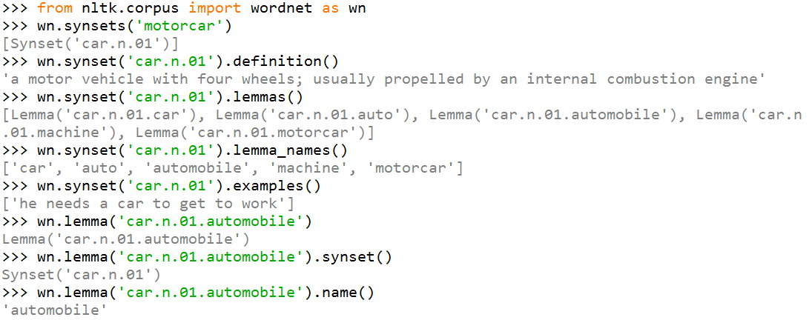
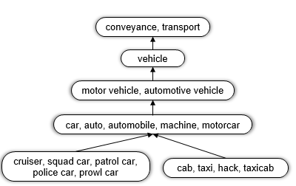

Slide 29
Combining neuro+symbolic structure

